Slide 1


BASICS OF POWERPOINT
By Prateek Panwar

Slide 2
INTRODUCTION TO MICROSOFT POWERPOINT
Microsoft PowerPoint is a powerful presentation software developed by Microsoft. It is a standard component of the company's Microsoft Office suite software, and is bundled together with Word, Excel and other Office productivity tools.
The program uses slides to convey information rich in multimedia and is used to create complex business presentations, simple educational outlines and much more.
PowerPoint became a component of the Microsoft Office suite, first offered in 1989 for Macintosh and in 1990 for Windows, which bundled several Microsoft apps. Beginning with PowerPoint 4.0 (1994), PowerPoint was integrated into Microsoft Office development, and adopted shared common components and a converged user interface.

Slide 3
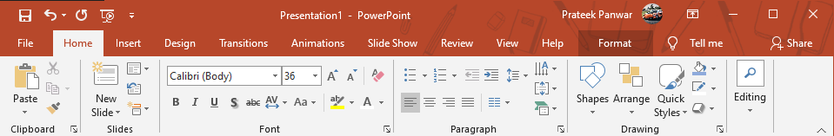
RIBBON
Ribbon is section to navigate through different functions of PowerPoint. The Ribbon is the strip of buttons across the top of the main window. Users can access anything the program has to offer through the Ribbon.

Slide 4
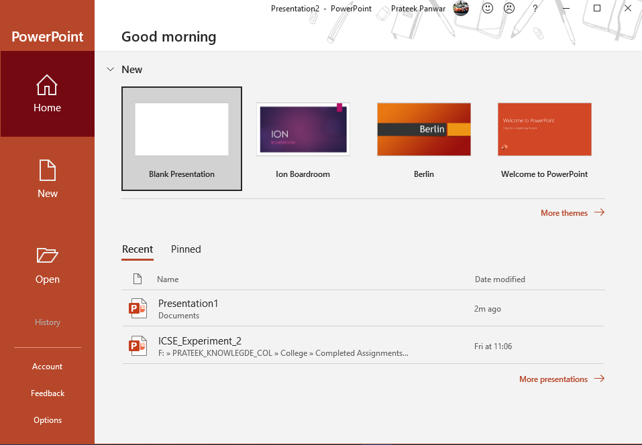
Create a presentation
Open PowerPoint.
Select an option:
1. Select Blank Presentation to create a presentation from scratch.
2. Select one of the templates.
3.Select Take a Tour, and then select Create, to see tips for using PowerPoint.

Slide 5
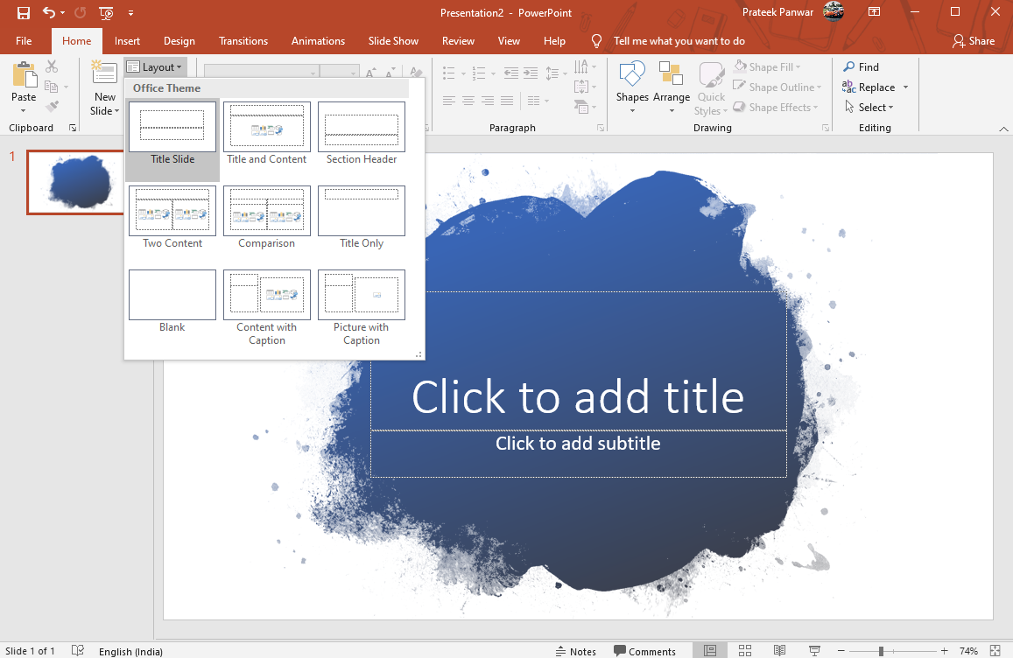
Add a slide
1. Select the slide you want your new slide to follow.
2. Select Home > New Slide.
3. Select Layout and the you type want from the drop-down.

Slide 6
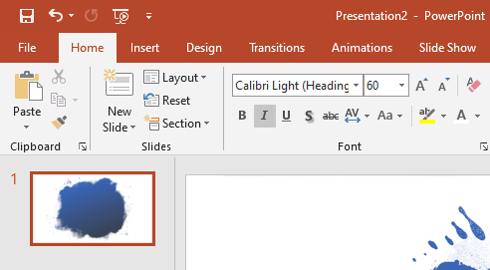
Add and format text
1. Place the cursor where you want, and type.
2. Select the text, and then select an option on the Home tab: Font, Font size, Bold, Italic, Underline, ...
3. To create bulleted or numbered lists, select the text, and then select Bullets or Numbering.

Slide 7
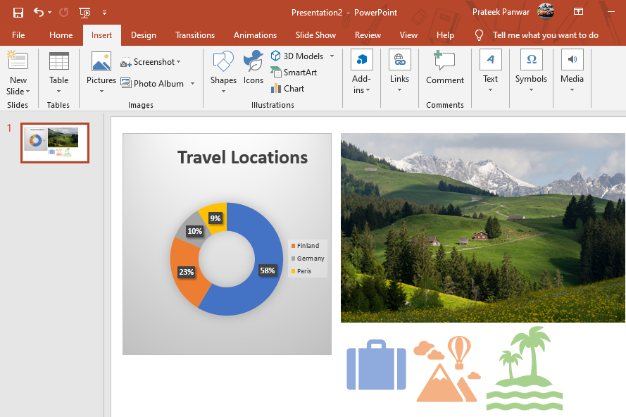
Add a picture, shape, or chart
1. Select Insert.
2. To add a picture:
Select Picture.
Browse for the picture you want and select Insert.
3. To add a shape, art, or chart:
Select Shapes, Icons, SmartArt, or Chart.
Select the one you want.

Slide 8
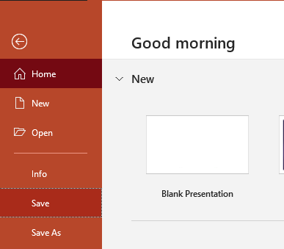
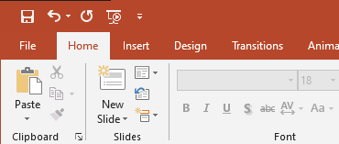
Save the Presentation
2
To save the presentation, We follow these steps:
1. In ribbon, Press File Button
2. Click on Save Button
3. Select either OneDrive or Offline location to save
1

Slide 9
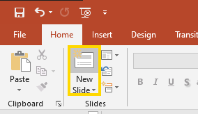
Add A Slide
In ribbon:
1. Click HOME and select the New Slide button
2. Select the Slide Pane and press Enter

Slide 10
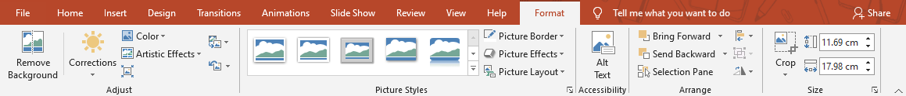
Format Pictures
To Format pictures, Follow these steps:
1. Click on Picture
2. Click on FORMAT ribbon 3. Select following options like Picture Border, Picture Effects, Picture Layout…

Slide 11
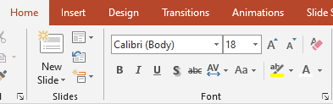
Format Fonts
To format Fonts:
1. Select TextBox
2. Goto HOME ribbon 3. In top left, Find Font Section 4. Select desired Font then size, color Example

Slide 12
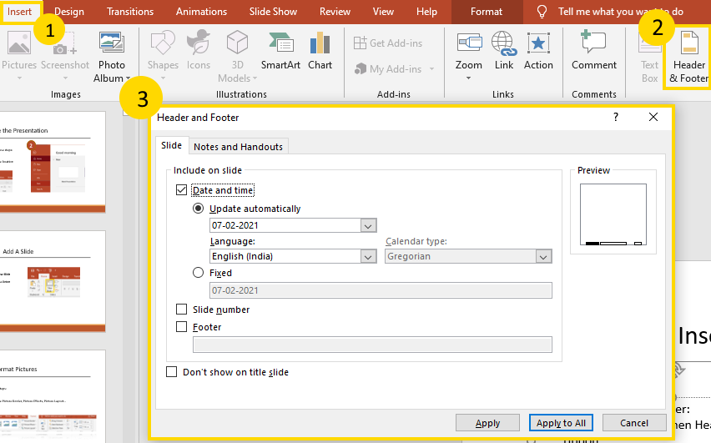
Insert Header and Footer
To insert Header and Footer: 1. Goto INSERT tab then Header and Footer ribbon 2. The dialog box will allow you to add header and footer

Slide 13
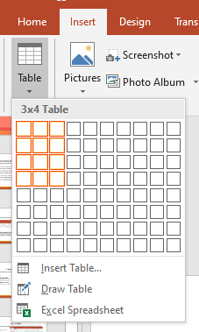
Insert Tables
To insert Table:
1. Goto Insert Tab 2. In Tables section, Click Table
3. Select desired Rows and columns 4. Format Table
Sample | Table
THIS IS | HOW
IT | LOOKS

Slide 14

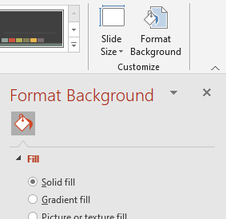
Select Theme
To select design:
1. Goto Design Tab
2. Select one of pre made theme To format background and modify theme:
1. Goto Design Tab 2. Select Format Background ribbon in Customize section and modify

Slide 15
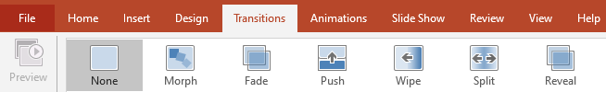

Select Transition
To select transition:
1. Goto Transitions Tab
2. Select one of pre made transition 3. Change Duration to your need 4. In Advance Slide section at right end of Menu bar, Select After 00:00 and enter time to change slide automatically after some time

Slide 16
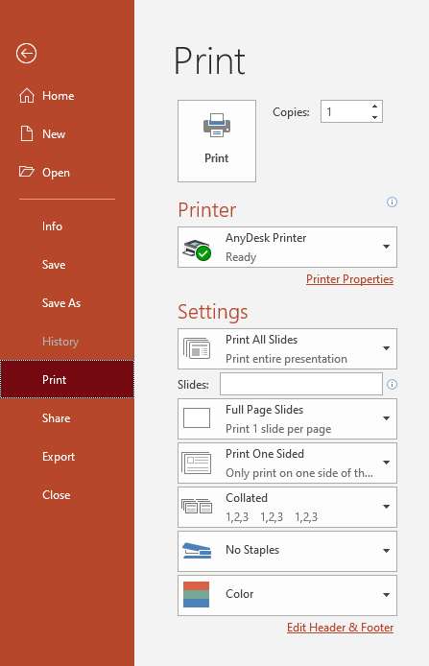
Print Presentation
To Print presentation slides:
1. Goto File tab
2. Click on Print and select options
3. Click Print

